Slide 2
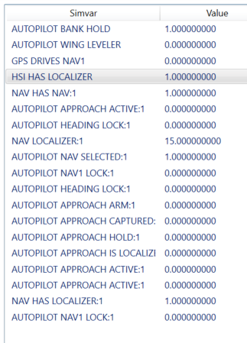
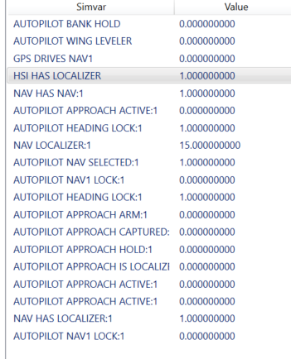
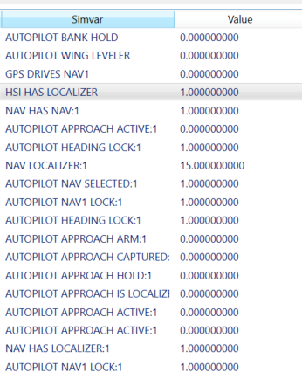
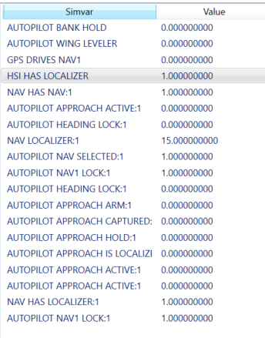
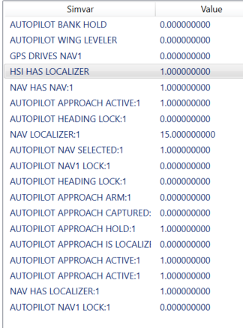
ROL mode, no armed (good)
HDG mode, no armed (good)
HDG mode, LOC armed (good)
Localizer (nav mode on approach) (good, but Armed mode still lit)
On final, but shows ROL instead of LOC.

Slide 3
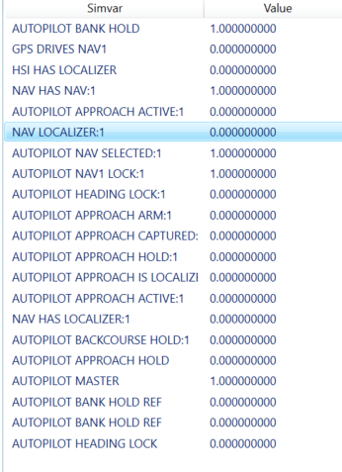
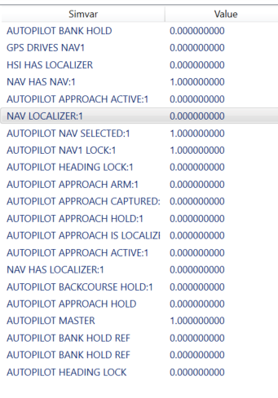
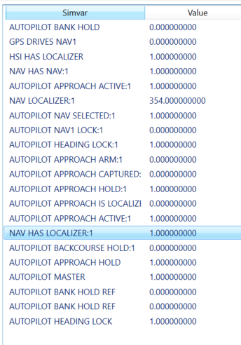
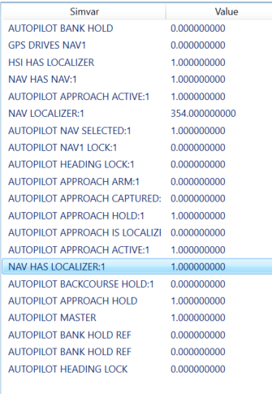
Approach mode. LOC armed
Approach mode. LOC captured.
In ROL mode, VOR armed (NAV mode)
NAV mode, VOR captured

Slide 4
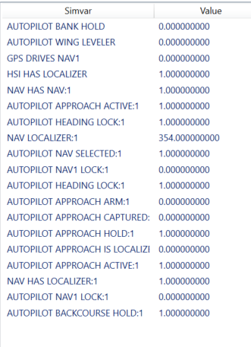
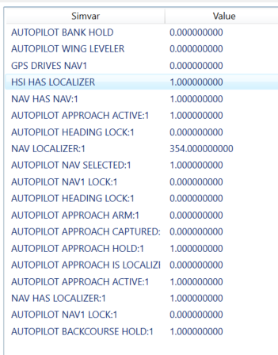
HDG to BC. Incorrectly shows LOC
BC Captured. Incorrectly shows LOC

Slide 5
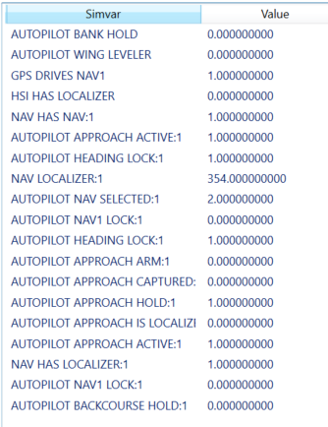
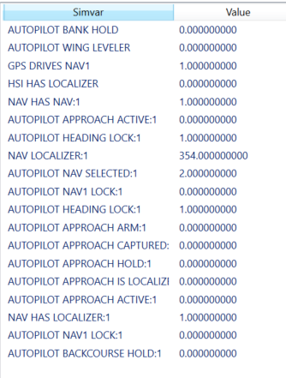
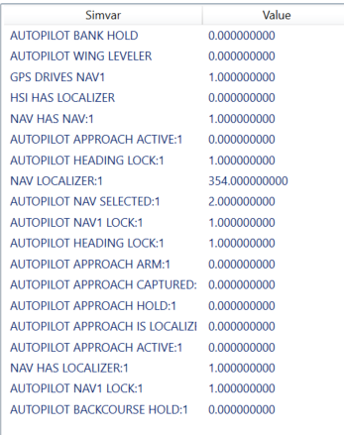
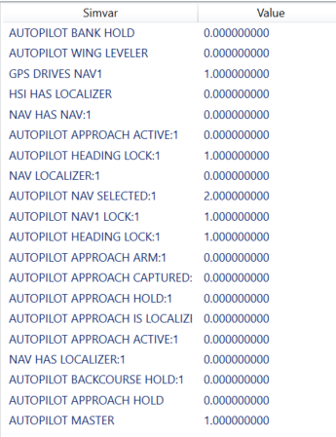
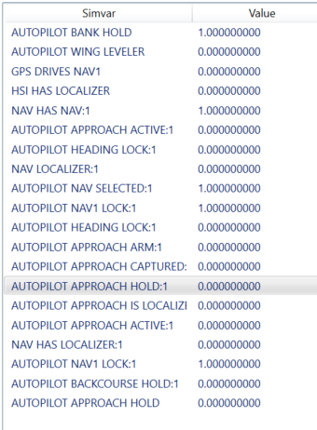
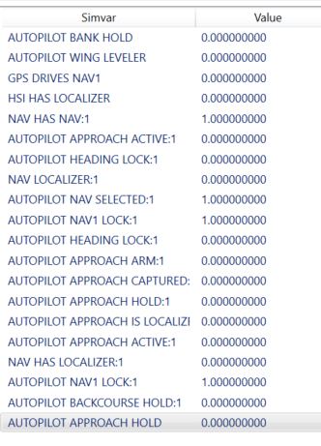
AP HDG mode to ILS approach. Armed incorrectly shows 0
HDG mode, nothing armed. Correctly shows 0.
HDG mode GPS Nav mode armed. Correctly shows 4
HDG mode GPS Nav mode armed. Correctly shows 4.
ROL mode with NAV to VOR
VOR Mode captured

Slide 6
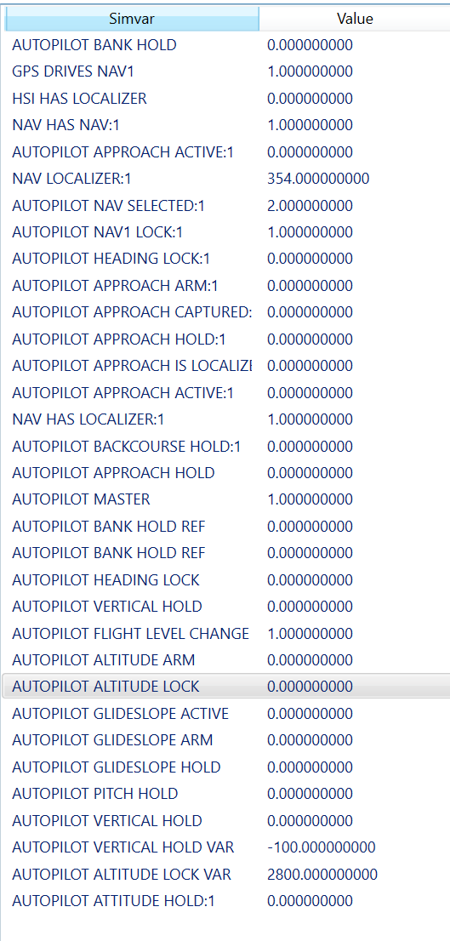
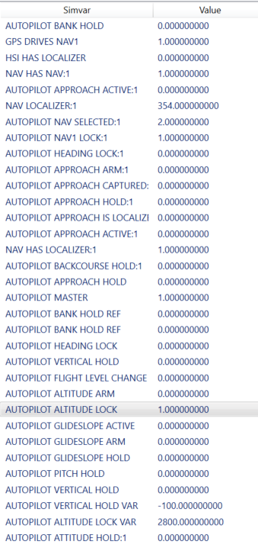
Vertical Armed Modes
IAS/FLC active. Climbing.
IAS done. Alt captured

